Slide 1

Daily Review
CFU 1
Which two objects are interacting?
Explaining Electrostatic Charge
State the two objects that are interacting. State which object is gaining electrons. State the relative charge of each object.
CFU 2
Which object is gaining electrons?
After bouncing on the trampoline for a while your hair starts to stand on end. You are gaining electrons from the trampoline mat through your feet.
CFU 2
What are the relative charges of the objects?
The ____ and the _____ are exchanging electrons. The electrons are moving from the _____ to the ______. The ______ is now relatively negative, and the _____ is relatively positive.
CFU 2
Think-pair-share: why are the strands of hair spreading out from each other?

Slide 2
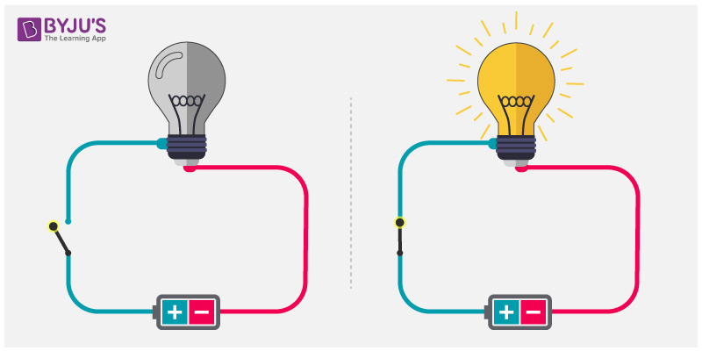
Daily review
CFU 1
List the 3 essential components of all electric circuits.
Electric Circuits
A pathway travelled by electrical energy
However all circuits have 3 essential components
A power source
A pathway
A load
We typically also put a switch into our
circuits, to allow us to control when they
are open and closed
CFU 2
In the simple circuit below, what is the load and the power source?

Slide 3
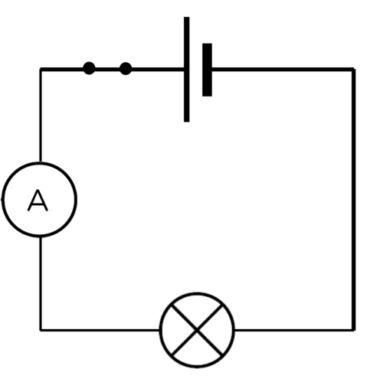
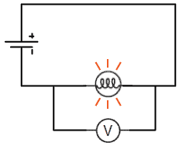
Daily review
CFU 1
Describe electrical current and how it is measured.
Electrical Current
The rate of flow of electric charge past a point.
Ammeter connected in series with the component to measure the current.
Voltage
This difference in potential energy across the globe is called the voltage or potential difference.
Voltmeters are installed in parallel across 2 points of the circuit.
CFU 2
Describe voltage and how it is measured.
CFU 3
Think pair share: differentiate between how a voltmeter and an ammeter is installed in a circuit.

Slide 4
Ohm’s Law Year 9 Physics

Slide 5
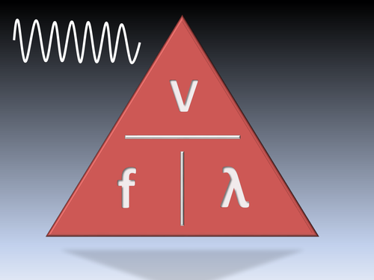
Learning Objectives
CFU
What are we going to learn today?
Describe Ohm’s Law
Use Ohm’s Law to calculate current, resistance and voltage in simple circuits.
Activate Prior Knowledge
This is the equation we used to calculate frequency, wave speed, and wave length of a wave.
Work with your partner to write on your whiteboard the 3 equations we can derive from this triangle.

Slide 6
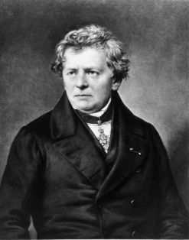
Concept Development
CFU 1
Who was Georg Ohm, and what did he discover?
Ohm’s Law
Georg Ohm (German physicist) discovered a relationship between current, voltage and resistance.
Ohm found that the voltage drop across a resistor is directly proportional to the current through the resistor.
CFU 2
Think-pair-share: As the voltage through a resistor increases, what effect does this have on the current?
Vocabulary
Directly proportional: as one amount increases, another amount increases at the same rate.

Slide 7
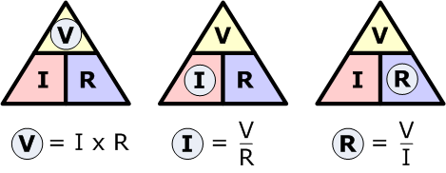
Concept Development
CFU 1
On your whiteboard write the 3 different equations for Ohm’s law.
Ohm’s Law
Ohm’s Law is mathematically represented as: V=IR
V= voltage in volts (V)
I= current in amperes (A)
R= resistance in ohms (Ω)
The equation can be rearranged as follows:
CFU 2
On your whiteboard write the equation you would use to calculate: Resistance Current Voltage
Vocabulary
Directly proportional: as one amount increases, another amount increases at the same rate.

Slide 8
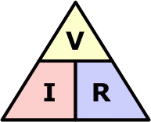
Skill Development
Comparing sound waves
Write down the information you are given, and what you are trying to find. Rearrange the equation to find your unknown. Put your numbers into the equation and solve. Add appropriate units.
An alarm clock draws 0.5 A of current when connected to a 120 V circuit. Calculate its resistance.
I= 0.5 A
V= 120 V
R= ?
2. R=V/I
3. R=120/0.5
R=240
4. The alarm clock has a resistance of 240 Ω

Slide 9
Skill Development
Comparing sound waves
Write down the information you are given, and what you are trying to find. Rearrange the equation to find your unknown. Put your numbers into the equation and solve. Add appropriate units.
An iPod uses a standard 1.5 V battery. How much resistance is in the circuit if it uses a current of 0.01A?
I= 0.01 A
V= 1.5 V
R= ?
2. R=V/I
3. R=1.5/0.10
R=150
4. The iPod has a resistance of 150 Ω

Slide 10
Skill Development
Comparing sound waves
Write down the information you are given, and what you are trying to find. Rearrange the equation to find your unknown. Put your numbers into the equation and solve. Add appropriate units.
A 12 Volt car battery pushes charge through the headlight circuit resistance of 10 ohms. How much current is passing through the circuit?
4. The current through the headlights is _____A
I= ______
V= ______
R= ______
2. I=V/___
3. I=12/10
I=1.2

Slide 11
Skill Development
Comparing sound waves
Write down the information you are given, and what you are trying to find. Rearrange the equation to find your unknown. Put your numbers into the equation and solve. Add appropriate units.
A light bulb has a resistance of 5 ohms and a maximum current of 10 A. How much voltage can be applied before the bulb will break?
4. __________________
____________________
I= ______
V= ______
R= ______
2. ______
3. ________
_______

Slide 12
Skill Development
Comparing sound waves
Write down the information you are given, and what you are trying to find. Rearrange the equation to find your unknown. Put your numbers into the equation and solve. Add appropriate units.
A circuit contains a 1.5 volt battery and a bulb with a resistance of 3 ohms. Calculate the current.
I= ______
V= ______
R= ______
2. ______
3. ________
_______
4. __________________
____________________

Slide 13
Skill Development
Comparing sound waves
Write down the information you are given, and what you are trying to find. Rearrange the equation to find your unknown. Put your numbers into the equation and solve. Add appropriate units.
If a toaster produces 12 ohms of resistance in a 120 volt circuit, what is the amount of current in the circuit?

Slide 14
Skill Closure
Looking at the triangle to the right, list the 3 equations that can be found from Ohm’s Law.
Skill Closure
What happens to the current in a circuit if a 1.5 volt battery is removed and is replaced by a 3 volt battery?
Vocabulary
Directly proportional: as one amount increases, another amount increases as the same rate.
Comparing sound waves
Write down the information you are given, and what you are trying to find. Rearrange the equation to find your unknown. Put your numbers into the equation and solve. Add appropriate units.
Skill Closure
An electric heater works by passing a current of 100 A though a coiled metal wire, making it red hot. If the resistance of the wire is 1.1 ohms, what voltage must be applied to it?

Slide 15
Independent Practice
Complete the Ohm’s Law worksheet.
If you finish early, complete questions 4, 5 and 6 in the Oxford text book on page 111.

